Slide 1
SS ZG 566 Secure Software Engineering
T V Rao

Slide 2
Threat Modelling Concepts RL 3.1

Slide 3
Securing a Computer Based System
A computer-based system has three separate but valuable components (Assets) :
Hardware
Software
Data
Vulnerabilities
Weaknesses in a system that may be able to be exploited in order to cause loss or harm
e.g., a file server that doesn’t authenticate its users
Threats
A loss or harm that might befall a system
e.g., users’ personal files may be revealed to the public

Slide 4
Characteristics of Computer Intrusion
By computing system, we include
Hardware
Software
Storage media
Data and
People
A system is most vulnerable at its weakest point
A robber will not attempt to penetrate a 2-inch-thick metal door if a window gives easy access

Slide 5
Principle of Easiest Penetration
An intruder must be expected to use any available means of penetration. The penetration may not necessarily be by the most obvious means, nor is it necessarily the one against which the most solid defense has been installed. And it certainly does not have to be the way we want the attacker to behave.

Slide 6
Threat Model
When designing a system, we need to state the threat model
Threat Model
Set of threats we are undertaking to defend against
Whom do we want to prevent from doing what?
Attack
An action which exploits a vulnerability to execute a threat
e.g., telling the file server you are a different user in an attempt to read or modify their files

Slide 7
Threats to Assets
According to Pfleeger, the threats are
Interruption – an asset is destroyed, unavailable or unusable (availability)
Interception – unauthorized party gains access to an asset (confidentiality)
Modification – unauthorized party tampers with asset (integrity)
Fabrication – unauthorized party inserts counterfeit object into the system (authenticity)

Slide 8
Threat Consequences (IETF RFC 4949)
Threat Consequence | Threat Action (Attack)
Unauthorized Disclosure A circumstance or event whereby an entity gains access to data for which the entity is not authorized | Exposure: Sensitive data are directly released to an unauthorized entity. Interception: An unauthorized entity directly accesses sensitive data traveling between authorized sources and destinations. Inference: A threat action whereby an unauthorized entity indirectly accesses sensitive data (but not necessarily the data contained in the communication) by reasoning from characteristics or by-products of communications. Intrusion: An unauthorized entity gains access to sensitive data by circumventing a system’s security protections.
Deception A circumstance or event that may result in an authorized entity receiving false data and believing it to be true | Masquerade: An unauthorized entity gains access to a system or performs a malicious act by posing as an authorized entity. Falsification: False data deceive an authorized entity. Repudiation: An entity deceives another by falsely denying responsibility for an act
Disruption A circumstance or event that interrupts or prevents the correct operation of system services and functions | Incapacitation: Prevents or interrupts system operation by disabling a system component. Corruption: Undesirably alters system operation by adversely modifying system functions or data. Obstruction: A threat action that interrupts delivery of system services by hindering system operation
Usurpation A circumstance or event that results in control of system services or functions by an unauthorized entity | Misappropriation: An entity assumes unauthorized logical or physical control of a system resource. Misuse: Causes a system component to perform a function or service that is detrimental to system security
Notes:
From Internet Engineering Task Force Glossary

Slide 9
Who are Attackers
One approach to prevention is to understand who carries out attacks and why
Amateurs
Ordinary computer professionals or users who, while doing their jobs, discover they have access to something valuable. Amateurs may be disgruntled employees who vow to get even with management
Crackers or Malicious Hackers
Attempt to access computing facilities for which they have not been authorized (often students who see it as victimless crime). Some carry out for curiosity, personal gain or self-satisfaction

Slide 10
Who are Attackers
Career Criminals
Understands the targets of computer crime; often begin as computer professionals, then shift to crime finding payoff. “They don’t want to write a worm that destroys your hardware. They want to assimilate your computers and use them to make money”
Terrorists
They use computers in three ways
Targets of attack – denial of service, web site defacement attacks are popular to attract attention to the cause and bring undesired negative attention to the targets of attack
Propaganda vehicles – inexpensive way to get a message to many
Methods of attack – use computers to launch attacks

Slide 11
Method, Opportunity, Motive
A malicious attacker must have three things
Method : the skills, knowledge, tools, and other things with which to be able to pull off the attack
Opportunity : the time and access to accomplish the attack
Motive : a reason to want to perform this attack against this system
Deny any of those three things and the attack will not occur.

Slide 12
Methods of defense
How can we defend against a threat?
Prevent it: prevent the attack
Deter it: make the attack harder or more expensive
Deflect it: make yourself less attractive to attacker
Detect it: notice that attack is occurring (or has occurred)
Recover from it: mitigate the effects of the attack

Slide 13
Methods of defense
Threat: your car may get stolen
How to defend?
Prevent: Immobilizer? Is it possible to absolutely prevent?
Deter: Store your car in a secure parking facility
Deflect: Have sticker mentioning car alarm, keep valuables out of sight
Detect: Car alarms
Recover: Insurance

Slide 14
Structured Approach to Threat Modeling
According to Adam Shostack, you begin threat modeling by focusing on four key questions
What are you building?
What can go wrong?
What should you do about those things that can go wrong?
Did you do a decent job of analysis (retrospect)

Slide 15
Structured Approach to Threat Modeling
People often use an approach centered on
Models of their assets (Valuable things they have),
Models of attackers (People who might go after assets), or
Models of their software (Common way to attack is via the deployed software)
Centering on one of these is preferable to using approaches that combine them because the combinations tend to be confusing
According to Adam Shostack, first two sets of models help in engaging with non-technical people and third type of models are important for software development

Slide 16
What Threat Modelling is (not)
What threat modelling is | What threat modelling is not
A team activity | An activity performed by a single team member in isolation
An activity that helps identify security vulnerabilities in a variety of software applications | Just for large software projects
An activity that should be performed for every iteration or sprint during agile development | An activity done once during the lifecycle of the project
www.microsoft.com

Slide 17
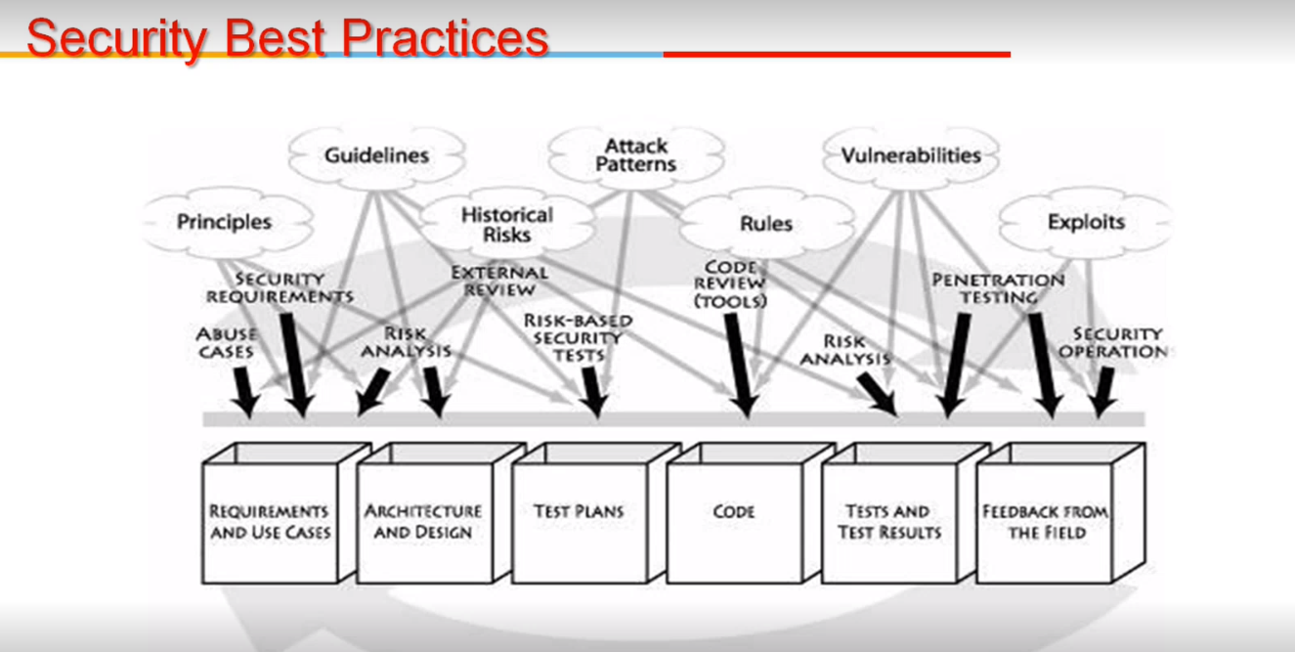

Slide 18
Thank You!

Slide 19
SS ZG 566 Secure Software Engineering
T V Rao

Slide 20
OWASP Threat Modelling Process – Part 1 RL 3.2.1

Slide 21
OWASP Threat Modeling
According to OWASP, the threat modeling process for software application can be decomposed into 3 high level steps
Decompose the Application
Determine and rank threats
Determine countermeasures and mitigation

Slide 22
Decompose the Application (step 1)
Understanding of the application and how it interacts with external entities.
involves creating use-cases to understand how the application is used,
identifying entry points to see where a potential attacker could interact with the application,
identifying assets i.e. items/areas that the attacker would be interested in, and
identifying trust levels which represent the access rights that the application will grant to external entities.
Produce data flow diagrams (DFDs) for the application. The DFDs show the different paths through the system, highlighting the privilege boundaries.

Slide 23
Determine and rank threats (step 2)
A threat categorization such as STRIDE can be used,
Spoofing
Tampering
Repudiation
Information disclosure
Denial of service
Elevation of privilege
The STRIDE categorization helps to identify threats from the attacker perspective.

Slide 24
Determine and rank threats (step 2)
A threat categorization ASF (Application Security Framework) defines threat categories such as
Auditing & Logging,
Authentication,
Authorization,
Configuration Management,
Data Protection in Storage and Transit,
Data Validation,
Exception Management.
The ASF categorization helps to identify threats from the defensive perspective.

Slide 25
Determine and rank threats (step 2)
DFDs produced in step 1 help to identify the potential threat targets from the attacker's perspective, viz.
data sources,
processes,
data flows, and
interactions with users.
Use and abuse cases can illustrate how existing protective measures could be bypassed, or where a lack of such protection exists.

Slide 26
Determine and rank threats (step 2)
These threats can be identified further as the roots for threat trees;
one tree for each threat goal.
From the defensive perspective, ASF categorization helps to identify the threats as weaknesses of security controls for such threats.
The determination of the security risk for each threat can be determined using a value-based risk model such as DREAD

Slide 27
Determine countermeasures and mitigation
A lack of protection against a threat might indicate a vulnerability whose risk exposure could be mitigated with the implementation of a countermeasure.
Countermeasures can be identified using threat-countermeasure mapping lists.
Based on risk ranking assigned to the threats, it is possible to sort threats from the highest to the lowest risk, and prioritize the mitigation effort, such as by responding to such threats by applying the identified countermeasures

Slide 28
Thank You!

Slide 29
SS ZG 566 Secure Software Engineering
T V Rao

Slide 30
OWASP Threat Modelling Process – Part 2 RL 3.2.2

Slide 31
OWASP Threat Modeling Example
Application Description:
The college library website is the first implementation of a website to provide librarians and library patrons (students and college staff) with online services. As this is the first implementation of the website, the functionality will be limited. There will be three users of the application:
1. Students 2. Staff 3. Librarians
Staff and students will be able to log in and search for books, and staff members can request books. Librarians will be able to log in, add books, add users, and search for books.

Slide 32
External Dependencies
External dependencies are items external to the code of the application that may pose a threat to the application. These items are typically still within the control of the organization, but possibly not within the control of the development team
ID | Description
1 | The database server will be MySQL and it will run on a Linux server. This server will be hardened as per the college's server hardening standard. This will include the application of the latest operating system and application security patches.
2 | The connection between the Web Server and the database server will be over a private network.

Slide 33
Trust Levels
Trust levels represent the access rights that the application will grant to external entities.
The trust levels are cross referenced with the entry points and assets.
This allows us to define the access rights or privileges required at each entry point, and those required to interact with each asset

Slide 34
Trust Levels
ID | Name | Description
1 | Anonymous Web User | A user who has connected to the college library website but has not provided valid credentials.
2 | User with Valid Login Credentials | A user who has connected to the college library website and has logged in using valid login credentials.
3 | User with Invalid Login Credentials | A user who has connected to the college library website and is attempting to log in using invalid login credentials.
4 | Librarian | The librarian can create users on the library website and view their personal information.
5 | Database Server Administrator | The database server administrator has read and write access to the database that is used by the college library website.
6 | Website Administrator | The Website administrator can configure the college library website.
7 | Web Server User Process | This is the process/user that the web server executes code as and authenticates itself against the database server as.
8 | Database Read User | The database user account used to access the database for read access.
9 | Database Read/Write User | The database user account used to access the database for read and write access.

Slide 35
Entry Points
Entry points define the interfaces through which potential attackers can interact with the application or supply it with data. In order for a potential attacker to attack an application, entry points must exist.
ID | Name | Description | Trust Levels
1.1 | Library Main Page | The splash page for the college library website is the entry point for all users. | (1) Anonymous Web User (2) User with Valid Login Credentials (3) User with Invalid Login Credentials (4) Librarian
1.3 | Search Entry Page | The page used to enter a search query. | (2) User with Valid Login Credentials (4) Librarian

Slide 36
Assets
Attacker is interested in the system because it has Assets
Assets can be
Physical – Private Data, List of customers etc.
Privilege – System has ability to update/process data
Abstract – Reputation of the organization
Assets are documented in the threat model as follows:
ID,
Name,
Description
Trust Level (required for access)

Slide 37
Assets
ID | Name | Description | Trust Levels
1 | Library Users and Librarian | Assets relating to students, faculty members, and librarians.
1.1 | User Login Details | The login credentials that a student or a faculty member will use to log into the College Library website. | (2) User with Valid Login Credentials, (4) Librarian, (5) Database Server Administrator, (7) Web Server User Process, (8) Database Read User, (9) Database Read/Write User
1.3 | Personal Data | The College Library website will store personal information relating to the students, faculty members, and librarians. | (4) Librarian, (5) Database Server Administrator, (6) Website Administrator, (7) Web Server User Process, (8) Database Read User, (9) Database Read/Write User
2 | System | Assets relating to the underlying system.
2.2 | Ability to Execute Code as a Web Server User | This is the ability to execute source code on the web server as a web server user. | (6) Website Administrator, (7) Web Server User Process
2.4 | Ability to Execute SQL as a Database Read/Write User | This is the ability to execute SQL. Select, insert, and update queries on the database and thus have read and write access to any information stored within the College Library database. | (5) Database Server Administrator, (9) Database Read/Write User
3 | Website | Assets relating to the College Library website.
3.1 | Login Session | This is the login session of a user to the College Library website. This user could be a student, a member of the college faculty, or a Librarian. | (2) User with Valid Login Credentials, (4) Librarian
3.3 | Ability to Create Users | The ability to create users would allow an individual to create new users on the system. These could be student users, faculty member users, and librarian users. | (4) Librarian, (6) Website Administrator

Slide 38
Data Flow Diagrams
Knowledge of Assets, Entry points, etc. help in creating DFDs.
The DFDs will allow us to gain a better understanding of the application by providing a visual representation of how the application processes data
DFDs focus on how data moves through the application and what happens to the data as it moves
DFDs are hierarchical in structure, so they can be used to decompose the application into subsystems and lower-level subsystems

Slide 39
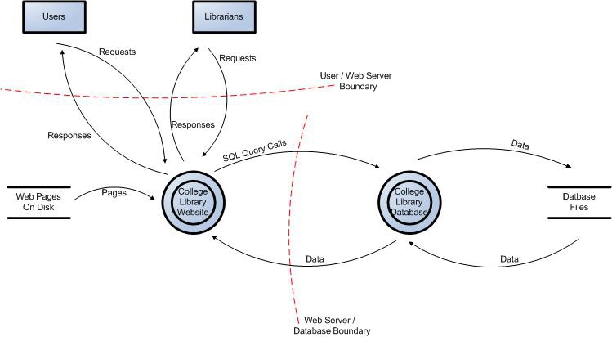
DFD for the example

Slide 40
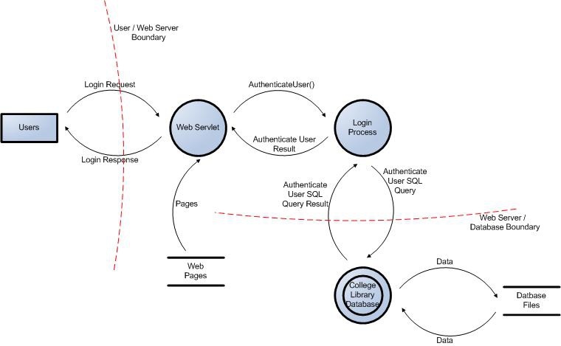
Partially Expanded DFD

Slide 41
Trust Boundaries in DFD
Add trust boundaries that intersect data flows
Points/surfaces where an attacker can interject
Machine boundaries, privilege boundaries, integrity boundaries are examples of trust boundaries
Threads in a native process are often inside a trust boundary, because they share the same privileges, rights, identifiers and access
Processes talking across a network always have a trust boundary
They may create a secure channel, but they’re still distinct entities
Encrypting network traffic doesn’t address tampering or spoofing
Iterate over processes, data stores, and see where they need to be broken down

Slide 42
Threats (STRIDE)
Type | Examples
Spoofing | Threat action aimed to illegally access and use another user's credentials, such as username and password.
Tampering | Threat action aimed to maliciously change/modify persistent data, such as persistent data in a database, and the alteration of data in transit between two computers over an open network, such as the Internet.
Repudiation | Threat action aimed to perform illegal operations in a system that lacks the ability to trace the prohibited operations.
Information disclosure | Threat action to read a file that one was not granted access to, or to read data in transit.
Denial of service | Threat aimed to deny access to valid users, such as by making a web server temporarily unavailable or unusable.
Elevation of privilege | Threat aimed to gain privileged access to resources for gaining unauthorized access to information or to compromise a system.

Slide 43
Example Countermeasures (ASF)
Threat Type | Countermeasure
Authentication | Credentials and authentication tokens are protected with encryption in storage and transit Protocols are resistant to brute force, dictionary, and replay attacks
Authorization | Strong ACLs are used for enforcing authorized access to resources Role-based access controls are used to restrict access to specific operations
Configuration Management | Least privileged processes are used and service accounts with no administration capability Auditing and logging of all administration activities is enabled
Data Protection in Storage and Transit | Standard encryption algorithms and correct key sizes are being used Hashed message authentication codes (HMACs) are used to protect data integrity
Data Validation / Parameter Validation | Data type, format, length, and range checks are enforced No security decision is based upon parameters (e.g. URL parameters) that can be manipulated
Error Handling and Exception Management | All exceptions are handled in a structured manner Error messages are scrubbed so that no sensitive information is revealed to the attacker
User and Session Management | No sensitive information is stored in clear text in the cookie Cookies are configured to expire
Auditing and Logging | Sensitive information (e.g. passwords, PII) is not logged Integrity controls (e.g. signatures) are enforced on log files to provide non-repudiation

Slide 44
Thank You!

Slide 45
SS ZG 566 Secure Software Engineering
T V Rao

Slide 46
SDL Threat Modeling – Part 1 RL 3.3.1

Slide 47
Objectives
Produce software that’s secure by design
Improve designs the same way we’ve improved code
Because attackers think differently
Creator blindness/new perspective
Allow you to predictably and effectively find security problems early in the process

Slide 48
Responsibilities
Building a threat model (at Microsoft)
Program Manager (PM) owns overall process
Testers
Identify threats in analyze phase
Use threat models to drive test plans
Developers create diagrams

Slide 49
Customers / Work Products
Customers for threat models
Your team
Other features, product teams
Customers, via user education
“External” quality assurance resources, such as pen testers
Threat model documentation
The product as a whole
The security-relevant features
The attack surfaces

Slide 50
The Process in a Nutshell
Diagram
Identify Threats
Mitigate
Validate

Slide 51
Diagramming
Use DFDs (Data Flow Diagrams)
Include processes, data stores, data flows
Include trust boundaries
Diagrams per scenario may be helpful
Update diagrams as product changes
Enumerate assumptions, dependencies
Number everything (if manual)

Slide 52
Effective Threat Modeling Meetings
Develop draft threat model before the meeting
Use the meeting to discuss
Start with a DFD walkthrough
Identify most interesting elements
Assets (if you identify any)
Entry points/trust boundaries
Walk through STRIDE against those elements
Threats that cross elements/recur
Consider library, redesigns

Slide 53
Validating Threat Models
Validate the whole threat model
Does diagram match final code?
Are threats enumerated?
Minimum: STRIDE per element that touches a trust boundary
Has Test / QA reviewed the model?
Tester approach often finds issues with threat model or details
Is each threat mitigated?
Are mitigations done right?
Did you check these before Final Security Review?
Shipping will be more predictable

Slide 54
Thank You!

Slide 55
SS ZG 566 Secure Software Engineering
T V Rao

Slide 56
SDL Threat Modeling – Part 2 RL 3.3.2

Slide 57
Threat: Spoofing
Threat | Spoofing
Property | Authentication
Definition | Impersonating something or someone else
Example | Pretending to be any of billg, microsoft.com, or ntdll.dll

Slide 58
Threat: Tampering
Threat | Tampering
Property | Integrity
Definition | Modifying data or code
Example | Modifying a DLL on disk or DVD, or a packet as it traverses the LAN

Slide 59
Threat: Repudiation
Threat | Repudiation
Property | Non-Repudiation
Definition | Claiming to have not performed an action
Example | “I didn’t send that email,” “I didn’t modify that file,” “I didn’t visit that web site”

Slide 60
Threat: Information Disclosure
Threat | Information Disclosure
Property | Confidentiality
Definition | Exposing information to someone not authorized to see it
Example | Allowing someone to read the Windows source code; publishing a list of customers to a Web site

Slide 61
Threat: Denial of Service
Threat | Denial of Service
Property | Availability
Definition | Deny or degrade service to users
Example | Crashing Windows or a Web site, sending a packet and absorbing seconds of CPU time, or routing packets into a black hole

Slide 62
Threat: Elevation of Privilege
Threat | Elevation of Privilege (EoP)
Property | Authorization
Definition | Gain capabilities without proper authorization
Example | Allowing a remote Internet user to run commands is the classic example, but going from a “Limited User” to “Admin” is also EoP

Slide 63
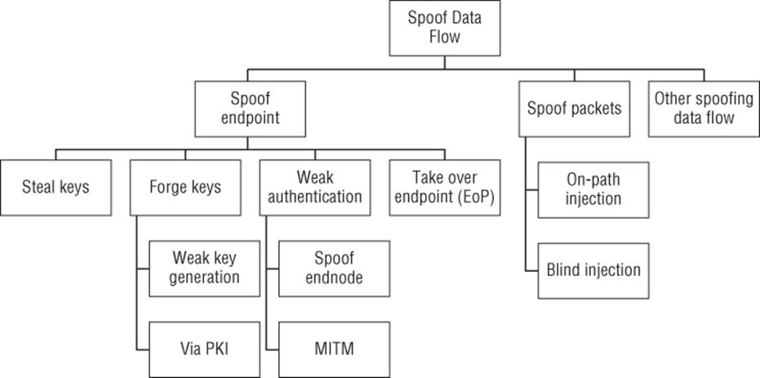
Threat Tree (Spoofing data flow)

Slide 64
How to Mitigate
Address each threat
Four ways to address threats
Redesign to eliminate
Apply standard mitigations
What have similar software packages done and how has that worked out for them?
Invent new mitigations (riskier)
Accept vulnerability in design

Slide 65
Standard Mitigations
Spoofing | Authentication | To authenticate principals: Cookie authentication Kerberos authentication To authenticate code or data: Digital signatures
Tampering | Integrity | ACLs Digital signatures
Repudiation | Non Repudiation | Secure logging and auditing Digital Signatures
Information Disclosure | Confidentiality | Encryption ACLS
Denial of Service | Availability | ACLs Filtering Quotas
Elevation of Privilege | Authorization | ACLs Group or role membership Privilege ownership Input validation

Slide 66
DREAD
In the Microsoft DREAD threat-risk ranking model, the technical risk factors for impact are Damage and Affected Users, while the ease of exploitation factors are Reproducibility, Exploitability and Discoverability. This risk factorization allows the assignment of values to the different influencing factors of a threat. To determine the ranking of a threat, the threat analyst has to answer basic questions for each factor of risk
For Damage: How big would the damage be if the attack succeeded?
For Reproducibility: How easy is it to reproduce an attack to work?
For Exploitability: How much time, effort, and expertise is needed to exploit the threat?
For Affected Users: If a threat were exploited, what percentage of users would be affected?
For Discoverability: How easy is it for an attacker to discover this threat?

Slide 67
DREAD Example
The college library website use case:
Threat: Malicious user views confidential information of students, faculty members and librarians.
Damage potential: Threat to reputation as well as financial and legal liability:8
Reproducibility: Fully reproducible:10
Exploitability: Require to be on the same subnet or have compromised a router:7
Affected users: Affects all users:10
Discoverability: Can be found out easily:10
Overall DREAD score: (8+10+7+10+10) / 5 = 9
In this case having 9 on a 10 point scale is certainly a high risk threat

Slide 68
Threat Modelling by Adam Shostack, John Wiley 2014
Security in Computing by Charles P. Pfleeger, Shari L. Pfleeger, and Deven Shah Pearson Education 2009
Computer Security: Principles and Practice by William Stallings, and Lawrie Brown Pearson, 2008.
www.owasp.com
www.microsoft.com

Slide 69
Thank You!

